Slide 1


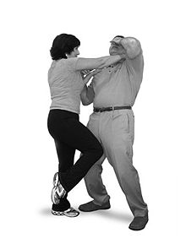
MANAGEMENT OF ASSAULTIVE BEHAVIOR
(MAB) AB 508
WORKPLACE VIOLENCE PREVENTION CERTIFICATION PROGRAM

Slide 2
COURSE OBJECTIVES
To get certified so you can get back to work and to get out early.
Safety for You, for the individual who is escalated along with anyone else in the area who may be in jeopardy.
Working together as a team, even ahead of time, to ensure the best possible outcome when dealing with potential violence.
Recognizing potential problems ahead of time so that you can initiate the most therapeutic effective interventions.

Slide 3
COURSE OBJECTIVES
Understanding why individuals become aggressive and what roles we the staff play in either de-escalating or provoking the behavior.
To learn how to DE-ESCALATE an upset or escalating individual or situation before it becomes violent.
To know when to remove yourself from the situation or area so the appropriate people can intervene.
Legalities and liabilities of defending yourself.
To learn ways to protect yourself when an individual becomes aggressive.

Slide 4
COURSE INTRODUCTION
This course was designed in compliance with OSHA, SB 1299 and AB 508. Completing this course will grant the student up to four (4) Continuing Education Units (CEUs) through the California Board of Registered Nursing (CE Provider Number 17260).

Slide 5
COURSE INTRODUCTION
All hospital employees regularly assigned to the emergency department are required to receive training and education relating to various security topics, including, but not limited to, general safety measures, aggression and violence predicting factors, and verbal and physical maneuvers to diffuse or avoid violent behavior, by January 1, 1995, and on a continuing basis thereafter as provided for in the security plan of the hospital. Prescribed medical and other staff are also required to receive the same security training or training determined sufficient pursuant to the security plan of the hospital.

Slide 6
COURSE INTRODUCTION
All general acute care, acute psychiatric, and special hospitals are required to conduct a security and safety assessment and to develop a security plan. This includes reporting of any act of assault or battery, as defined, against any on-duty hospital personnel to the local enforcement agency within 72 hours and would make any individual knowingly interfering with or obstructing the reporting process guilty of a misdemeanor, thereby imposing a state-mandated local program.

Slide 7

COURSE INTRODUCTION
In addition, it is required that the negotiator consider the ability of the contracting hospital to provide a secure environment for the provision of health care services, as prescribed.

Slide 8
COURSE INTRODUCTION
Violence is an escalating problem in hospital emergency departments throughout California and the nation. The emergency department is particularly vulnerable to violence because of its accessibility to all members of the public. The emergency department is open 24 hours a day, seven days a week, to anyone desiring care.

Slide 9
COURSE INTRODUCTION
During the past few years in California, deaths to nurses and other health care workers occurred in emergency rooms, psychiatric hospitals, and community mental health clinics. Actual incidence of the problem in all types of health care facilities is greater than documented because of failure to report or failure to maintain records of incidents that are reported.

Slide 10
COURSE INTRODUCTION
All hospitals shall conduct a security and safety assessment and, using the assessment, develop a security plan with measures to protect personnel, patients, and visitors from aggressive or violent behavior. The security and safety assessment shall examine trends of aggressive or violent behavior at the facility. These hospitals shall track incidents of aggressive or violent behavior as part of the quality assessment and improvement program and for the purposes of developing a security plan to deter and manage further aggressive or violent acts of a similar nature.

Slide 11

COURSE INTRODUCTION
The plan may include, but shall not be limited to, security considerations relating to all of the following:
(1) Physical layout
(2) Staffing
(3) Security personnel availability
(4) Policy and training related to appropriate responses to violent acts

Slide 12
COURSE INTRODUCTION
In developing this plan, the hospital shall consider any guidelines or standards on violence in health care facilities issued by the state department, the Division of Occupational Safety and Health, and the federal Occupational Safety and Health Administration. As part of the security plan, a hospital shall adopt security policies including, but not limited to, personnel training policies designed to protect personnel, patients, and visitors from aggressive or violent behavior.

Slide 13
COURSE INTRODUCTION
The individual or members of a hospital committee responsible for developing the security plan shall be familiar with all of the following:
(1) The role of security in hospital operations.
(2) Hospital organization.
(3) Protective measures, including alarms and access control.

Slide 14
COURSE INTRODUCTION
(4) The handling of disturbed patients, visitors, and
employees.
(5) Identification of aggressive and violent predicting
factors.
(6) Hospital safety and emergency preparedness.
(7) The rudiments of documenting and reporting crimes,
including, by way of example, not disturbing a crime scene.

Slide 15

COURSE INTRODUCTION
The hospital shall have sufficient personnel to provide security. Persons regularly assigned to provide security in a hospital setting shall be trained regarding the role of security in hospital operations, including the identification of aggressive and violent predicting factors, and management of violent disturbances.

Slide 16
COURSE INTRODUCTION
Any act of assault against any on-duty hospital personnel shall be reported to the local law enforcement agency within 72 hours of the incident. Any individual knowingly interfering with or obstructing the reporting process shall be guilty of a misdemeanor.

Slide 17
COURSE INTRODUCTION
All hospital employees regularly assigned to the emergency department shall receive, by July 1, 1995, and thereafter, on a continuing basis, security education and training relating to the following topics:
(1) General safety measures.
(2) Personal safety measures.
(3) The assault cycle.
(4) Aggression and violence predicting factors.
(5) Obtaining patient history from a patient with violent
behavior.

Slide 18
COURSE INTRODUCTION
(6) Characteristics of aggressive and violent patients and
victims.
(7) Verbal and physical maneuvers to diffuse and avoid
violent behavior.
(8) Strategies to avoid physical harm.
(9) Restraining techniques.
(10) Appropriate use of medications as chemical restraints.
(11) Any resources available to employees for coping with incidents of violence, including, by way of example, critical incident stress debriefing or employee assistance programs.

Slide 19
COURSE INTRODUCTION
Members of the medical staff of each hospital and all other practitioners, including, but not limited to, nurse practitioners, physician assistants, and other personnel, who are regularly assigned to the emergency department or other departments identified in the security plan shall receive the same training as that provided to hospital employees or, at a minimum, training determined to be sufficient pursuant to the security plan.

Slide 20

COURSE INTRODUCTION
Temporary personnel shall be oriented as required pursuant to the security plan. This section shall not be construed to preempt state law or regulations generally affecting temporary personnel in hospitals.

Slide 21
COURSE INTRODUCTION
The factors to be considered by the negotiator in negotiating contracts under this article, or in drawing specifications for competitive bidding, include, but are not limited to, all of the following:
(a) Beneficiary access.
(b) Utilization controls.
(c) Ability to render quality services efficiently and
economically.
(d) Demonstrated ability to provide or arrange needed
specialized services.
(e) Protection against fraud and abuse.

Slide 22
COURSE INTRODUCTION
(f) Any other factor which would reduce costs, promote
access, or enhance the quality of care.
(g) The capacity to provide a given tertiary service, such as specialized children's services, on a regional basis.
(h) Recognition of the variations in severity of illness and complexity of care.
(i) Existing labor-management collective bargaining agreements.
(j) The situation of county hospitals and university medical centers contracting with counties for provision of health care to indigent persons entitled to care under Section 17000, which are burdened to a greater extent than private hospitals with bad debts, indirect costs, medical education programs, and capital needs.

Slide 23
COURSE INTRODUCTION
(k) The special circumstances of hospitals serving a disproportionate number of Medi-Cal beneficiaries and patients who are not covered by other third-party payers, including the costs associated with assuring an adequate supply of registered nurses.
(l) The costs of providing complex emergency services, including the costs of meeting and maintaining state and local requirements for trauma center designation.

Slide 24
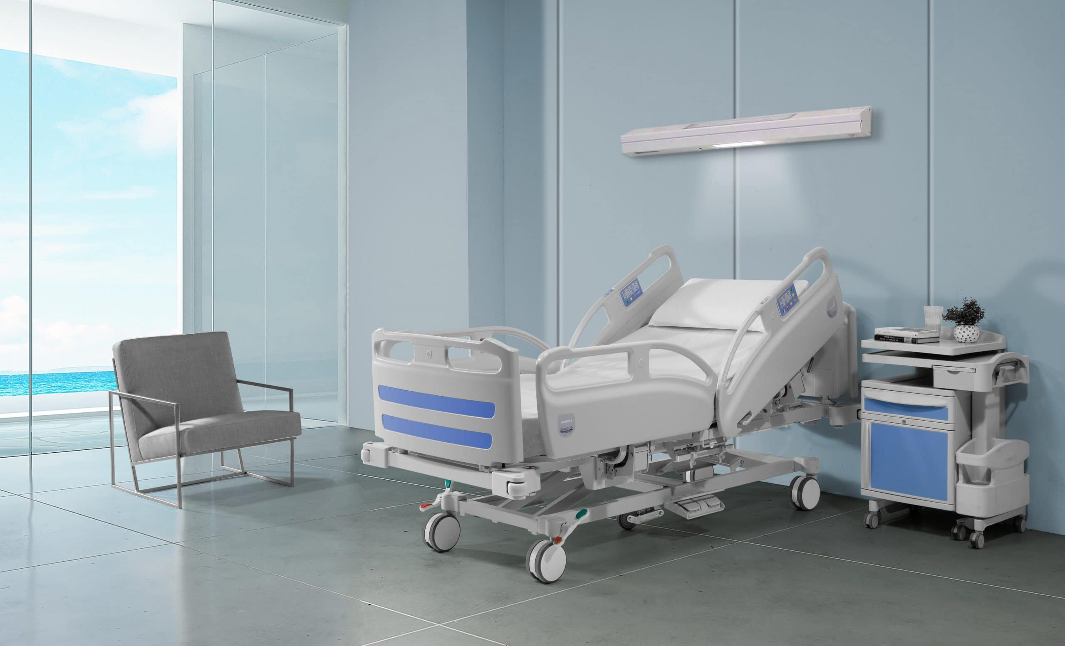
COURSE INTRODUCTION
(m) The hospital does any of the following:
(1) Provides additional obstetrical beds.
(2) Contracts with one or more comprehensive perinatal providers.
(3) Permits certified nurse midwives, subject to hospital rules, and consistent with existing laws and regulations, to admit patients to the health facility.
(4) Expands overall obstetrical services in the hospital.

Slide 25
COURSE INTRODUCTION
(n) The special circumstances of hospitals whose Medi-Cal inpatient utilization rate exceeds the mean Medicaid inpatient utilization rate by at least one-half of one standard deviation.
(o) The ability and capacity of the contracting hospital in a closed health facility planning area to provide health care services to beneficiaries who are in life threatening or emergency situations but have been sufficiently stabilized at another noncontracting facility in order to facilitate transportation to the contracting hospital.

Slide 26
COURSE INTRODUCTION
(p) The ability of the contracting hospital to provide a secure environment for the provision of health care services. In this regard, the negotiator shall consider additional security measures that the contracting hospital may have taken to provide a secure environment, including, but not limited to, the use of detection equipment or procedures to detect lethal weapons, the appropriate use of surveillance cameras, limiting access of unauthorized personnel to the emergency department, installation of bullet proof glass as appropriate in designated areas, the use of emergency "panic" buttons to alert local law enforcement agencies, and assigning full-time security personnel to the emergency department.

Slide 27

Part One - Recognition

Slide 28
Introduction
You are at work, minding your own business, until suddenly someone comes in and they are visibly upset. As a courtesy, you ask if they are okay. They aren’t. They unload their frustration on you. You try to console them, but it does not work; If anything, they just become more upset: they start yelling and using coarse or—worse of all—threatening language. So, what should you do?

Slide 29
Introduction
It is not uncommon for any workplace to experience some sort of hostility. Escalated events that may lead to physical violence such as “bad blood” between co-workers, jilted exes or estranged family members, or enraged clients/customers/patients can trigger the “Fight-or-Flight” response in all persons involved in the reciprocal side of the situation. It is normal and extremely valid to feel scared, but it is our duty to protect not only ourselves but everyone around us from potential harm. Sometimes, this includes the aggressor, too.

Slide 30

Introduction
This is the TRICKIEST part of the situation as everyone has different thresholds for threatening behavior. If your decision as a recipient of aggressive behavior is to Defend and/or Subdue, it is IMPERATIVE your choice(s) is ABSOLUTELY JUSTIFIED, otherwise you and your workplace (but mostly you) will have BROKEN THE LAW and can be faced with a lawsuit!

Slide 31
OBJECTIVES
Effective workplace safety from hostile situations can be broken down into three main objectives:
RECOGNIZING POTENTIAL PROBLEMS AHEAD OF TIME
UNDERSTANDING WHY INDIVIDUALS BECOME AGGRESSIVE
DE-ESCALATING AN UPSET INDIVIDUAL/SITUATION BEFORE IT’S TOO LATE

Slide 32
THE FOUR CATEGORIES OF WORKPLACE VIOLENCE
Type I: Violent acts by people who have no connection with the workplace, other than to commit a crime.
Type II: Violence directed at employees by customers, clients, patients, inmates, or others for whom an organization provides services to.
Type III: Violence against coworkers, supervisors or managers by a present or former employee.
Type IV: Violence committed by someone from outside who has a personal relationship with an employee.

Slide 33

CRITERIA NEEDED FOR SECLUSION & RESTRAINTS & PHYSICAL INTERVENTION
IMMINENT DANGER TO SELF
IMMINENT DANGER TO OTHERS

Slide 34
PERCEIVED THREAT
Perceived Threat is what activates our own psychological responses which determine our decisions of whether to Escape, Defend Ourselves, or Subdue an Individual when faced with a Crisis, or responding to a potentially dangerous situation within our environment.
Perceived Threat is what determines our decision of whether either Criteria is met and whether to take an individual down or not. It has to the most precise decision possible. If the decision is wrong and criteria is not met, then we have Broken the Law and Violated someone’s Human and Civil Rights.
Perceived Threat along with D.T.S. & D.T.O. is one of the largest Grey Areas in our field and the most Dangerous. Everyone has a Different Perception of Threat and that leaves Everything up for Interpretation.

Slide 35

PERCEIVED THREAT
If one person makes the decision whether to take an individual down, or intervenes either verbally or
physically, there’s less than a 50/50 chance that it will be the right decision, or that the incident will go well.
If a Team makes the same decision, then it goes up to around 80 to 85 % that it will be the right decision, or that the incident will go well.

Slide 36
WHAT ARE SOME OF THE IDENTIFIED REASONS FOR VIOLENCE WITHIN THE HEALTHCARE SETTING?
One person initiated the wrong decision, or One person intervened into the situation either verbally or physically by themselves, creating a Power Struggle.
One person, or a group of people entered the situation too early, unorganized, without enough information, without enough people, or without a plan.
The High Acuity or the Negative Energy Level of the facility, unit or individuals within the milieu.
The state of our economy has produced a much higher need for outside healthcare and behavioral health help and resources.

Slide 37
WHAT ARE SOME OF THE IDENTIFIED REASONS FOR VIOLENCE WITHIN THE HEALTHCARE SETTING?
The state of our economy has also produced the necessity to dramatically reduce and cut the resources available to those who would need it.
The effect is an imbalance of the essential resources needed vs. resources available dynamic.
The result is the higher rate of people who may have had some previous resources, who now do not and so they are entering into the healthcare environment as sicker and more needy, while flooding into areas that are not used to that type of client or situation.

Slide 38

HELPING THE SITUATION: HOW DO WE INFLUENCE THIS IN OUR FAVOR? HOW DO WE NARROW THE GREY AREA?
We influence this with The Triad of Successful Interventions:
Effective Communication
Coordinated Teamwork
Having a Plan of Action in place

Slide 39
HELPING THE SITUATION: HOW DO WE INFLUENCE THIS IN OUR FAVOR? HOW DO WE NARROW THE GREY AREA?
Within any highly-charged and potentially assaultive incident, there will always be some people who feel that the individual in crisis should be physically contained, while others feel that they should not.
This demonstrates that the grey area will always be present and that we will always experience a division between those who do and those who don’t believe someone should be taken down.

Slide 40
WHY DO PEOPLE GET TO THE POINT WHERE THEY LOSE CONTROL?
Withholding cigarettes, food, drinks and medications
Physical or verbal abuse
Denial of visitors
Withholding or overuse of medication
Whispering or talking too loudly regarding the clients in their presence
Laughing at or around disturbed clients
Staring too intensely at, or not visually acknowledging the client
The environment is too noisy or bright
The staff look like someone the client hates or fears
The client is held against their will and they want to leave

Slide 41
WHY DO PEOPLE GET TO THE POINT WHERE THEY LOSE CONTROL?
The client does not want to leave or be discharged from the facility
The client is experiencing psychosis, hallucinations or delusions
Demand for compliance
Making unreasonable demands of clients
Sarcasm during interactions between staff and clients
Rude and hostile treatment of clients
Failure to provide confidentiality
Touching or getting too close to clients who have physical boundary issues Individual or…
…group punishments especially in public
Giving double messages Inconsistencies and violations of the established routines
Favoritism Inflexible schedules which do not allow for individual needs

Slide 42
WHY DO PEOPLE GET TO THE POINT WHERE THEY LOSE CONTROL?
Rushing a client
Long wait times for clients
Being too punitive or parental with clients
Arguing with a client Interrupting while a client speaks
Not being attentive to the client while they are speaking
Poorly timed confrontations
The lack of positive reinforcement
Not providing adequate physical and emotional stimulation for clients
Overriding another staff member’s decision without explanation
Making too many decisions for the client

Slide 43
WHY DO PEOPLE GET TO THE POINT WHERE THEY LOSE CONTROL?
The lack of respect or rejection of the client
Failure to follow through with promises
Conscious or unconscious innuendos and seduction of clients
Passing the client along from one staff member to another without explanation
Emotional boundary violations
Lying to clients
Patronizing or ridiculing clients

Slide 44
WHY DO PEOPLE GET TO THE POINT WHERE THEY LOSE CONTROL?
Ignoring clients
Unresponsiveness to the
client’s needs
Threatening, intimidating or accusing clients
Time-outs without explanation
Excessive or unnecessary restrains and/or seclusions
The threat or loss of privileges
Violations or limitations of rights Mishandling personal belongings

Slide 45

THERE ARE ONLY TWO FUNDAMENTAL REASONS WHY
Communication
They don't have the ability to communicate, or coping skills to develop the communication process, or they have learned badly and behave the only way they know how to get attention or what they want.

Slide 46

THERE ARE ONLY TWO FUNDAMENTAL REASONS WHY
Symptom of Their Illness
Drunk, on drugs, psychotic, low functioning, autistic, reaction to medications, dementia… Something having to do with their illness that would promote them to become aggressive or strike out because of it.

Slide 47
THERE ARE ONLY TWO FUNDAMENTAL REASONS WHY
Communication - Find out What they Want, What they Need and What they are trying to Say.
Symptoms of Their Illness - Be prepared for something Action or Physical but try Communication before it becomes Physical.
We must first try to understand why people do what they do before we will be able to know what to do about or with them. The first dynamic to understand about them, is that it has very little to do with us.

Slide 48

THE THREE DYNAMICS OF BEGINNING A SUCCESSFUL NEGOTIATION
Try to understand as much about the Individual or Situation you are faced with.
Try to understand Your Reaction to the Individual or Situation you are faced with.
Try to understand how to attempt to Solve the Issue you are faced with.

Slide 49

TRIGGER WORDS
No.
What’s Bothering you?
What’s the Problem?
What’s Wrong?
Why…
Come Here.
You Need to…
Anytime you start out with ”You...”

Slide 50
TRIGGER WORDS
Having only two reasons helps to eliminate some of the Mystery from the situation or Crisis to where you are able to identify it. When you can identify the Crisis, then you will know more about how to approach it. When you are better able to approach the situation, then you’ll be better able to solve it.

Slide 51
Self-assessment
True or False: Criteria needed for seclusion and restraints and physical intervention include imminent danger to self, and to others.
Click on the button that corresponds to your answer.
True
False

Slide 52
Self-assessment
The correct answer is: True.
Proceed to the next question. >>>

Slide 53
Self-assessment
True or False: If a Team makes the same decision, then it goes up to around 80 to 85 % that it will be the right decision, or that the incident will go well.
Click on the button that corresponds to your answer.
True
False

Slide 54
Self-assessment
The correct answer is: True.
Proceed to the next question. >>>

Slide 55
Self-assessment
True or False: We don’t need to understand why people do what they do to know what to do about or with them.
Click on the button that corresponds to your answer.
True
False

Slide 56
Self-assessment
The correct answer is: False.
Proceed to the next lesson. >>>

Slide 57

PART TWO - DEFENSE

Slide 58
CONTROLLING BEHAVIOR VS. DE-ESCALATION
When there is no threat involved… No Danger to Self, or Others, then is not our job, nor responsibility to Control Behavior.
By attempting to Control the Behavior, we instantly initiate a Power Struggle.
Power Struggles escalate the incident further.
Power Struggles will only be settled by force.
Someone has to win & someone has to lose.

Slide 59

CONTROLLING BEHAVIOR VS. DE-ESCALATION
Step One: Get the dialogue moving two ways, either positive or negative, if vital information is being exchanged.
Step Two: Find out what that individual Needs.

Slide 60
CONTROLLING BEHAVIOR VS. DE-ESCALATION
Once you have reached Step Two, only then do you have any hope of solving the issue by Negotiation. If you initiate a Power Struggle, it will prevent you from reaching Step Two, and therefore there will be no hope of solving the issue, only settling it using force.

Slide 61

INSTRUMENTAL BEHAVIOR
Instrumental, or Attention-Based Behavior is characterized by superficial demands and clearly recognizable objectives that, if attained, will benefit the subject, such as the individual with a gun to their own head, that propels you or anyone else present to realize that you need to pay attention to the individual because this is serious and therefore should try to give the individual what they demand.

Slide 62

EXPRESSIVE BEHAVIOR
Expressive, or Emotional Need Behavior, is designed to communicate the subject's frustration, outrage, passion, despair, anger, or other feelings that are sometimes stemming from a long-term histrionic dynamic, where the individual feels as though they have not been listened to or understood to the point where they exceed their normal coping abilities.

Slide 63
BEHIND THE BEHAVIOR
There is always something behind the behavior that is pushing the
behavior toward you and therefore we shouldn’t take the
behavior personally, but instead realize that there is a deeper issue that the individual wishes us to reach, but they are unable to express, so it is our responsibility to reach it.
Never focus on the behavior, or the individual will focus on the behavior. Focus what is behind the behavior instead. What is making them feel like doing what they are doing? Ask them to help you understand what they need… How can I help? What can I do? How can we make the situation better or go away?

Slide 64
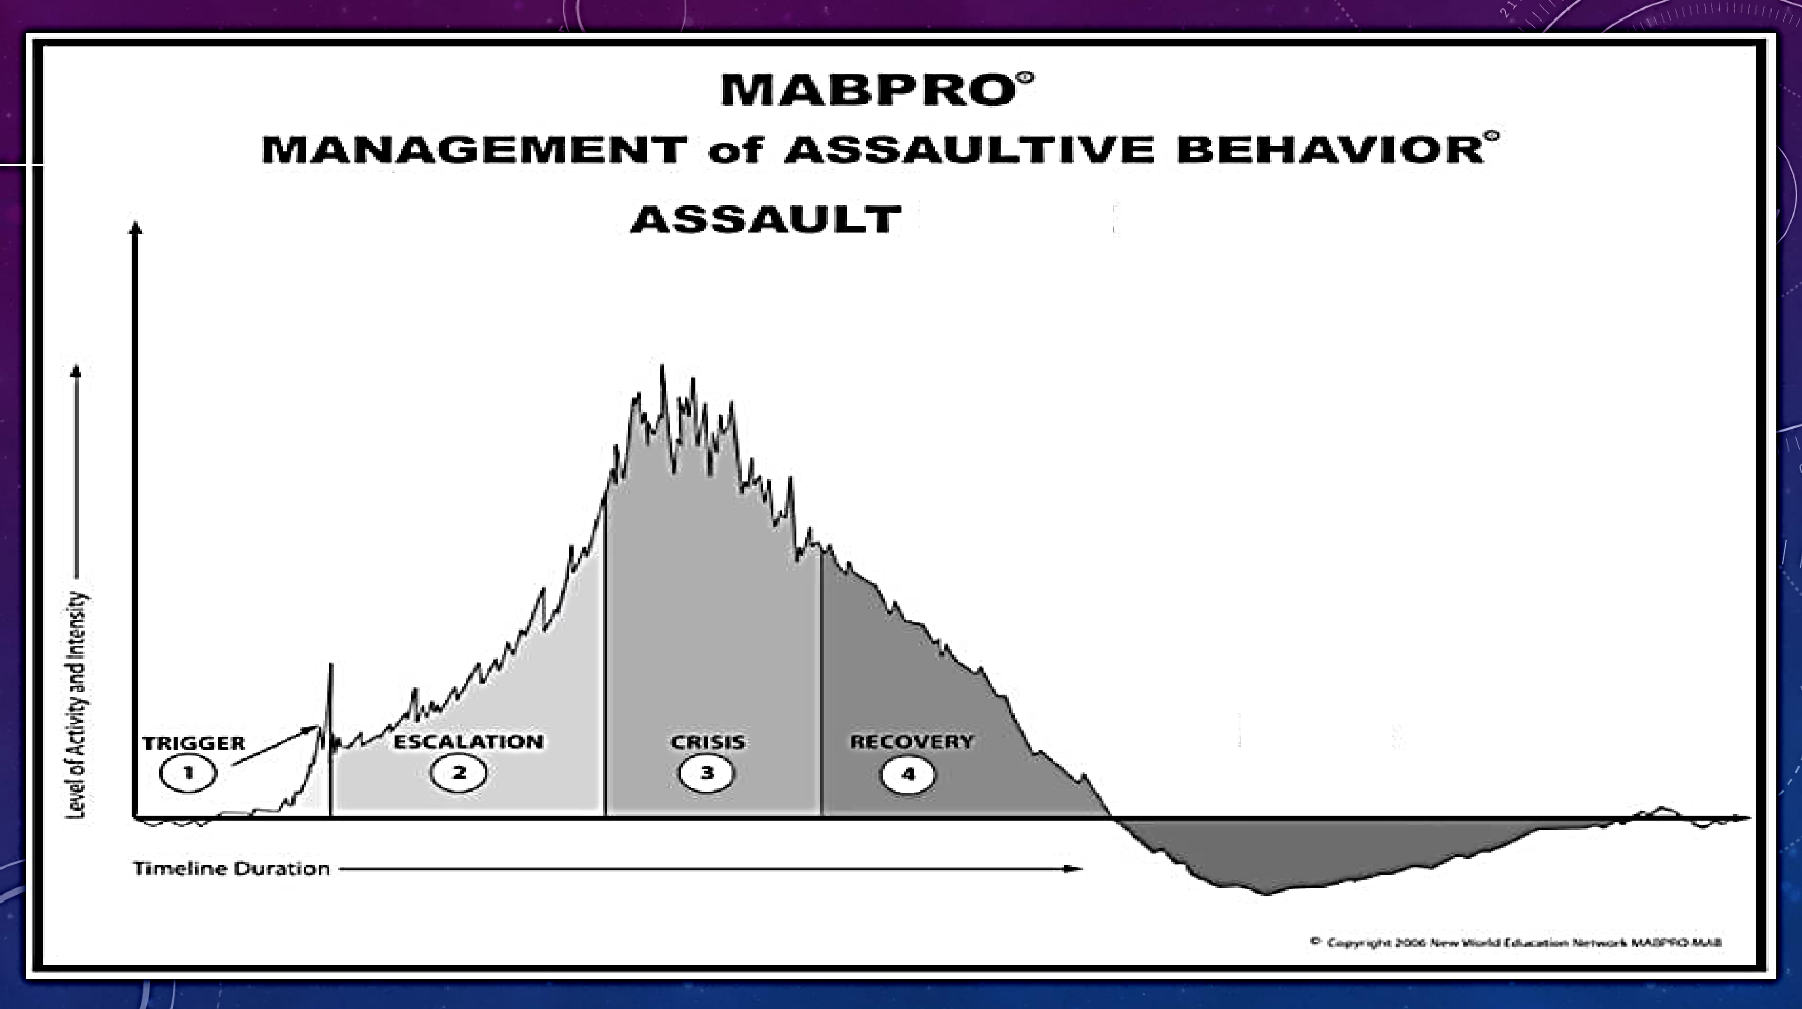
C '¥ C . E
P O ·
0 ,-::. - .
0
- ' l,S,
0 ·1

Slide 65

REDIRECTION/DISTRACTION
Redirection and Distraction is the process where the responder takes the initiative to direct the actions away from the crisis and toward a direction that the responder guides to, instead of allowing the individual to control the outcome.

Slide 66
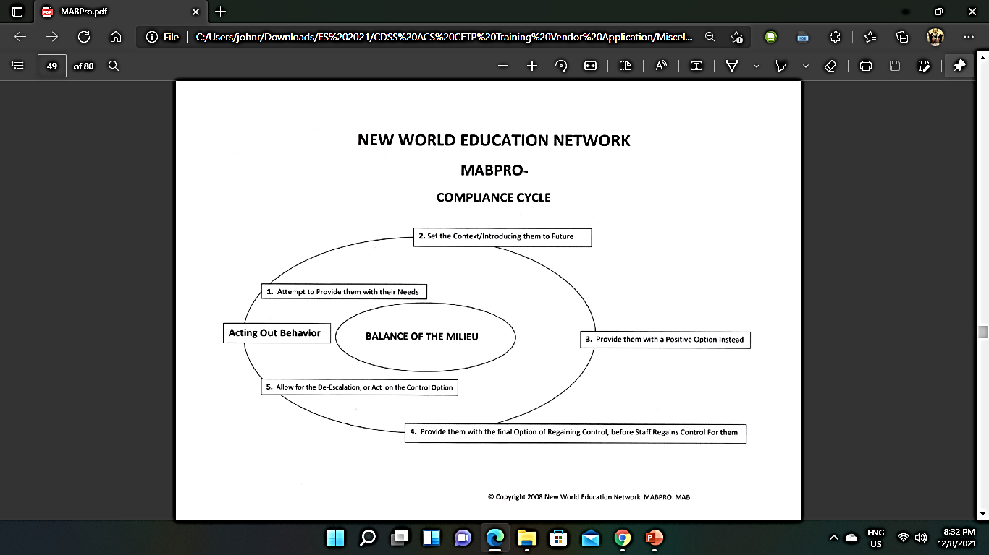

Slide 67
TYPES OF COMMUNICATION
COMMUNICATION IS A TWO-WAY process. The SENDING and
RECEIVING of messages Sending a message that is understood UNDERSTANDING the message that is sent.
AUDITORY - HEARING, SPEAKING, AUDITORY LANGUAGE (Failure to listen and communicate effectively affects working relationships)
VISUAL - SEEING, VISUALIZING, VISUAL MESSAGES, BODY LANGUAGE
KINESTHETIC - PHYSICAL ACTIONS EITHER POSITIVE OR NEGATIVE

Slide 68

IMPORTANT ELEMENTS
ACTIVE LISTENING PROVIDING EVIDENCE OF LISTENING
DEMONSTRATING TOTAL ATTENTION
OFFERING GOOD EYE CONTACT
NOT INTERRUPTING
NOT INSERTING YOUR OWN OPINION
REFLECTING BACK WHAT YOU HEARD
EXHIBITING POSITIVE BODY LANGUAGE
ASKING APPROPRIATE QUESTIONS

Slide 69
12 ELEMENTS OF ACTIVE LISTENING
1. Emotional Labeling - Emotional Labeling allows someone to see that we’re seeing their perspective by attaching a tentative label to the feelings expressed or implied by the person's words and actions. It also helps to attach an overall emotion in the beginning that the person may be feeling about the issue, such as; “This must be very frustrating for you” or “I understand, you must be really angry over this.”

Slide 70
12 ELEMENTS OF ACTIVE LISTENING
2. Paraphrasing - The use of this technique is demonstrated by your repeating in the person’s own words, the meaning of what you believe to be what the person is trying to communicate. As you listen, you should attempt to provide evidence of your attention by paraphrasing the person's words by stating; “So what you’re saying is you believe I could’ve said what I said differently… Alright, I think I understand.”

Slide 71

12 ELEMENTS OF ACTIVE LISTENING
3. Mirroring - This is utilized by repeating only the most important concepts, or the last few words of the individual's dialogue to gain a better understanding of their core issues and thus, being able to develop a much more effective rapport. After the person has explained that they were promised to be on this particular unit, you reply with; “You were promised to be on this unit… I understand what you’re saying."

Slide 72
12 ELEMENTS OF ACTIVE LISTENING
4. Minimal Encouragement - These responses do not need to be lengthy, but instead should be brief, well-timed vocal replies, such as; "Alright," "O.K.," or "I see." In this way, you can provide evidence that you are listening and understanding to what is being said, rather than simply hearing the words. This will help encourage the person to continue communicating with you, rather than shutting down and feeling unheard.

Slide 73
12 ELEMENTS OF ACTIVE LISTENING
5. Open-Ended Questions - This method helps you to focus on learning what the person is really thinking and feeling so that you can develop a roadmap of where to go and what to focus on in order to understand their feelings and intent. An example
might be; "I’d like to help you and in order to do that, I need more information on just how you feel.”

Slide 74
12 ELEMENTS OF ACTIVE LISTENING
6. Directive "I" Messaging - By using “I” messages, you portray a much more level playing field and in doing so, remove yourself from the elevated authority figure when the person may already feel that they are on a different
level than you. “I” messages should be made up of three main elements, the first being The problem or situation, the second being your feelings about the issue and the third, the reason for your concern.

Slide 75

12 ELEMENTS OF ACTIVE LISTENING
7. Effective Silence - People have a conscious or even subconscious reflex to speak in order to fill gaps and spaces within a conversation. You can obtain a true sense of what the person is thinking and feeling by utilizing silence as a method of encouraging the person to voluntarily fill the gaps. Even the most emotionally-charged individuals find it uncomfortable to stay engaged within a one-sided argument and will eventually calm.

Slide 76
12 ELEMENTS OF ACTIVE LISTENING
8. Perception Checking - This is done by trying to understand the feelings and emotions behind the words spoken by the individual, or to tap into the root cause of the issue. There is sometimes a deeper issue that is going on behind the issue at hand and when you try to discover the deeper issue that is lurking behind the overt one. This will actually serve to satisfy an emotional need that will in turn, help allow the person to trust you and open up.

Slide 77
12 ELEMENTS OF ACTIVE LISTENING
9. Clarifying - This is the process of following up to understand both the content and context of the words or feelings expressed by the person in order to check for accuracy of understanding in order to clear up any misperceptions that may have occurred during an emotionally-charged conversation. An example of this would be; “Can you tell me again what you meant when you said that you don’t feel like you’re being heard by
administration.”

Slide 78

12 ELEMENTS OF ACTIVE LISTENING
10. Structuring - It is sometimes necessary to create guidelines or parameters for the conversation in order for the person to feel as though there is a defined direction that the conversation is going so that there is a sense of purpose. As an example, you might say; “You mentioned that you don’t feel that this issue is in your best interest and that you’re afraid you’ll be blamed.”… “Which one of these issues would you like to talk about first?”

Slide 79
12 ELEMENTS OF ACTIVE LISTENING
11. Pinpointing - During confrontations, there can be so many emotionally-charged topics that the person is dealing with internally and externally, that the issues themselves may become lost in purpose. Therefore, you may need to at times redirect the conversation back to the most important issues. An example would be; “I hear you saying that you’re feeling better now, but I’m still seeing some tears”... “Is
everything really okay now?”

Slide 80
12 ELEMENTS OF ACTIVE LISTENING
12. Body Language and Posturing - Physical messages or body language from a person can either validate or discount the message we are trying to convey, and the body language exhibited by you can sabotage even the best of intentions. Examples of negative body language would be checking your watch, working on an unrelated task, interrupting, fidgeting, sighing, taking a phone call, or standing at the doorway instead of face to face while listening.

Slide 81

STRATEGIES TO ENSURE A CLEAR MESSAGE
ACKNOWLEDGE THAT YOU HEARD THE MESSAGE
BE AWARE OF YOUR TENDENCY TO JUDGE, ”YOUR WAY” AS RIGHT AND ALL OTHERS AS WRONG.
ALLOW FOR APPROPRIATE DIFFERENCES IN STYLES MEET ON COMMON GROUND

Slide 82
AWARENESS
BE AWARE OF SIMILARITIES BETWEEN YOU AND THE RECEIVER.
USE THESE SIMILARITIES TO DEVELOP A RELATIONSHIP AND TRUST.
ACKNOWLEDGE THAT DIFFERENCES CAN BE BOTH DIFFERENT & STILL BE APPROPRIATE
MODIFY YOUR APPROACH TO ADDRESS THE COMMUNICATION NEEDS OF THE RECEIVER

Slide 83

GIVING MESSAGES APPROPRIATELY
USE POSITIVE LANGUAGE AVOID USING “BUT”, “CAN’T”, OR “DON”T”. THIS NEGATES THE FIRST PART OF THE STATEMENT.
CORRECT MISTAKES WITH A SUPPORTIVE TONE “THE NEXT TIME THIS HAPPENS YOU MAY WANT TO TRY…”

Slide 84
NON-VERBAL COMMUNICATION
BE AWARE OF THE SIGNIFICANCE OF NON- VERBAL COMMUNICATION.
AVOID NON-VERBAL MESSAGES THAT APPEAR NEGATIVE SUCH AS: ROLLING EYES, LOSS OF EYE CONTACT POINTING OR WAGGING FINGERS DEEP SIGHS, CLEARING THROAT

Slide 85

OVERCOMING BARRIERS
RECOGNITION OF DIFFERENCES
ACKNOWLEDGEMENT OF MESSAGES
EXPLORING DIFFERENT APPROACHES
BEING EMPATHETIC
REINFORCEMENT
BEING A GOOD LISTENER
PARAPHRASE WHAT YOU HAVE BEEN TOLD

Slide 86
EFFECTIVE LISTENING
SET THE STAGE - Choose an appropriate place, Remove distractions, Be open and accessible Listen with empathy
SUSPEND JUDGEMENT - Concentrate, Keep an open mind, Hear them out
SUPPORTIVE BEHAVIORS - Relaxed, open body posture
FEEDBACK THAT ACKNOWLEDGES THAT YOU UNDERSTOOD THE MESSAGE - Reflect feelings, Paraphrase main ideas, Interrupt ONLY to clarify, Confirm next steps

Slide 87
LISTENING EXERCISE
Who are the people in your life that are easiest to listen to?
What is it about these people that makes it easy to listen to them?
Who are the people that you listen to the least?
What is it about them that makes it difficult to listen to them?

Slide 88
BEING A GOOD SPEAKER
LOOK AT THE PERSON WHEN TALKING TO THEM
PRONOUNCE WORDS CLEARLY
DON’T TALK TOO QUICKLY OR TOO SLOWLY
USE WORDS THEY CAN UNDERSTAND
DON’T TALK TOO LONG WITHOUT ALLOWING THE
OTHER TO SPEAK

Slide 89
COMMUNICATION STYLES
DIRECTOR - HANDS-ON, LOGICALLY ORGANIZED, USES ALL SENSES
EXPRESSOR - LOGICAL PRESENTATION,VERBALIZING
THINKER - PROBLEM SOLVING
HARMONIZER - NURTURING, HEALERS, CARE- GIVERS

Slide 90

KEYS TO COMMUNICATION
TO UNDERSTAND ANOTHER PERSON, WE MUST BE WILLING TO BE INFLUENCED WHEN WE ARE OPEN, WE GIVE PEOPLE ROOM TO RELEASE THEIR FIXED POSITIONS AND CONSIDER ALTERNATIVES SEEKING TO UNDERSTAND LETS US ACT FROM A POSITION OF KNOWLEDGE BY SEEKING TO UNDERSTAND WE GAIN INFLUENCE IN THE RELATIONSHIP

Slide 91
ARIS AGGRESSION SCALE AGGRESSION REACTION & INTERVENTION SCALE
BASELINE BEHAVIOR
DETONATION REFLEX
ESCALATION REACTION
REDIRECTION LEVELING
CRISIS APEX
RECOVERY DESCENT
SUBLEVEL EQUALIZATION
EQUALIZATION

Slide 92
TEN GUIDELINES FOR AVOIDING ASSAULT
Is there Imminent Danger to Self or Others and to what degree?
Try to Understand the Person or Situation that you’re faced with.
Try to Understand your Reaction to the Person or Situation that
you’re faced with.
Try Not to focus on the Behavior…Focus on what’s Behind the Behavior… There’s usually something behind the Behavior that’s causing it.
Try Not to tell them what to do or demand their compliance…Try
to Ask for their compliance instead.

Slide 93
TEN GUIDELINES FOR AVOIDING ASSAULT
One Team leader should be negotiating, not several… If more than one
person is trying to de-escalate the individual, it creates a Conflict of Focus.
Try to initiate a Plan before entering any potentially violent situation.
Work as a Team… Everyone has a role to offer in helping to de-escalate the situation.
Reactive Thinking always creates Primitive Responses… Critical Thinking
allows a person to help solve the situation by prompting you to ask
yourself questions of why the individual might be upset and what you can do to help them communicate their needs.
Try to always focus on the power of De-escalation, rather than giving into the weakness of Over-Reaction.

Slide 94

KEYS TO COMPLIANCE
COMPASSIONATE TEAMWORK
DEFENSIVE INTERVENTION

Slide 95
CASE STUDY 1
John has been a registered nurse for about five years. He usually works in the medical surgical and telemetry float pool; however, tonight, he has been asked to float to the Emergency Department. Around midnight, police arrive with Jane, a 50-year-old female threatening to harm herself and her family. During the assessment, John finds: a cooperative, though disheveled woman, with an odor of alcohol and superficial lacerations to her hands. Her history, supplied by both the police officers and her husband describe combativeness at the scene, threats to harm herself, depression with crying since losing her job, with an escalation of the symptoms in the last two weeks.

Slide 96
CASE STUDY 1
John, having just completed the workplace violence training knows he should:
Click on the button that corresponds to the letter of your choice.
A. Respond to Jane in a calm and reassuring manner.
B. Call security immediately.
C. Restrain Jane as she may be impaired by alcohol.
D. Call for an experienced emergency department nurse to care for Jane.

Slide 97
CASE STUDY 1
Answer: Did you pick “A”? You are correct! Jane is exhibiting no signs of agitation now and treating her in a calm reassuring manner may keep her from escalating. Calling for Security and restraining her may lead to more aggressive behavior.

Slide 98
CASE STUDY 2: SITUATION ESCALATES
John helps Jane get comfortable in a room and with the aid of a female nurse assists Jane into a hospital gown and getting labs drawn. John checks with Jane to see if she needs anything, she says no, and he goes to provide care to another patient. Jane's husband is in the room and the police officers remain outside the room. Upon his return, he sees Jane pacing about and talking to herself. Jane's jaw is clenched, and she is balling her fists. Her husband states that she is upset that the doctor has not been in to see her and she wants to leave.

Slide 99
CASE STUDY 2: SITUATION ESCALATES
John checks his watch and notes that only 15 minutes has passed. He would:
Click on the button that corresponds to the letter of your choice.
A. Instruct the husband to tell Jane to be patient, after all this is an emergency department and the doctors are busy.
B. Tell Jane if she does not calm down, he will remove her husband and lock the door.
C. Speak to Jane in a calm, non-threatening voice, apologize to Jane for the long wait and ask if she is okay.
D. Tell Jane she is free to leave at any time.

Slide 100
CASE STUDY 2: SITUATION ESCALATES
Answer: What was the best course of action? Exactly! “C” Maintaining his calming manner will help de-escalate the situation.

Slide 101
CASE STUDY 3: AGGRESSION ESCALATES
However, Jane is not appeased, she begins to hit her head against the wall and kick the bed. Her turn to more aggressive behavior should be treated by:
Click on the button that corresponds to the letter of your choice.
A. Giving her a sedative dose to calm her down.
B. Placing her in restraints and seclusion.
C. Placing her in a room designed to keep her from hurting herself and placing a sitter outside her room.
D. Calling the police officers into the room to control her.

Slide 102
CASE STUDY 3: AGGRESSION ESCALATES
Answer: In this circumstance, John chose "C". Why? Even though placing her in a room designed to keep her from hurting herself is a type of restraint, she will be under constant observation. This is the least invasive type of restraint and may be effective enough to calm Jane.

Slide 103
CASE STUDY CONCLUSION
The laboratory results are back, and the physician is here to examine Jane. He notes that Jane has calmed and is sorry for her behavior. She admits that she has been depressed and drinking, since losing her job. She feels worthless and thinks her husband is unhappy with her. She might as well kill herself and free him. What should the physician do? Did you consider a psychiatric consult?
Would you let her go home? Would you keep her safe until the alcohol dissipates? Would have the physician prescribe a common antidepressant?
The physician diagnoses depression and her labs show she is legally impaired by her alcohol consumption. He is not an expert in depression but knows the effects of the alcohol will wear off. He orders a psychiatric consult and admits Jane to the substance abuse ward.

Slide 104

PART THREE - LEGAL

Slide 105
Legal Aspects
If we’re lucky, scary events like these may never happen in our workspace. Or perhaps it did. We have discussed the skills needed to diffuse a possible assault before it happens, now let’s talk about how we could protect ourselves before and after an incident occurs under the law.

Slide 106
Legal Aspects
In 1993, a law was created to require all hospital employees to receive training in various security topics, such as aggression and violence, and verbal and physical maneuvers to diffuse of avoid violent behavior on a continuing basis.

Slide 107
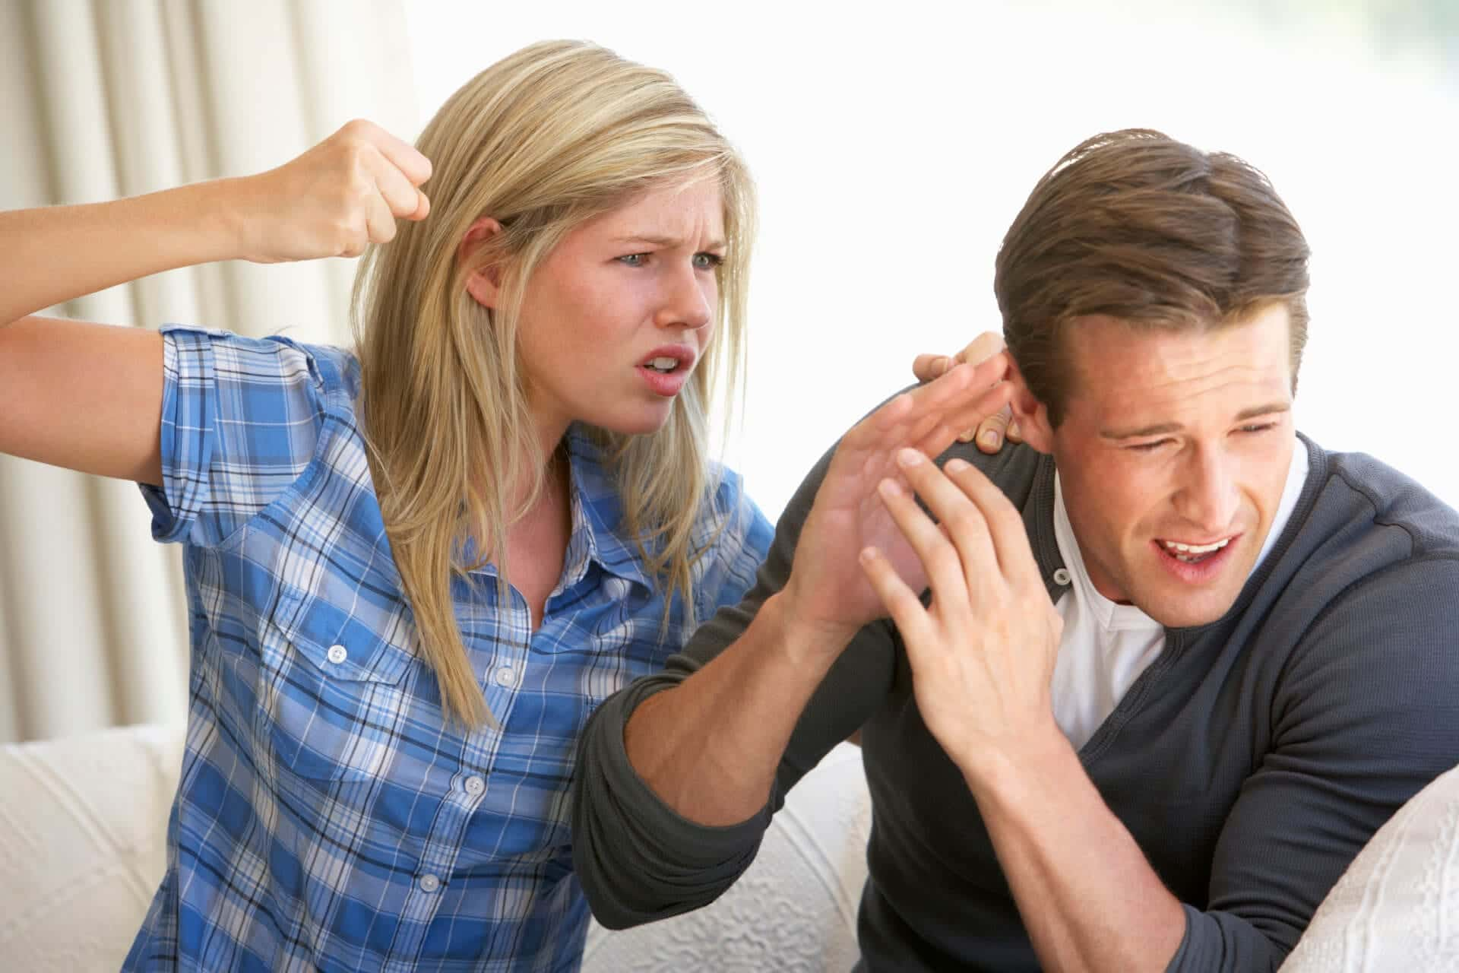
Legal Aspects
The law also mandates that any act of assault or battery against any on-duty personnel (including janitors) be reported to a local law-enforcement agency within three days of the incident. Anyone knowingly interfering with the reporting process WILL be charged with a misdemeanor.

Slide 108
Legal Aspects
Though focused on hospital settings – especially the emergency department, which is VERY public and open 24/7 – this law was passed under the recognition that violence was an escalating problem in emergency departments not only in California but nationwide.

Slide 109

Legal Aspects
Nurses and other healthcare workers in emergency rooms, psychiatric hospitals, and community mental health clinics have died from violent situations on-duty within the past few years when this law was only a bill.

Slide 110
Legal Aspects
Before 1993, the number of incidents in ANY type of health care facility was in greater numbers than was documented because of the failure to report or failure to maintain records of said reports. In 1991, a national survey of emergency room nurses found that only two-thirds of them reported at least ONE assault during their careers, and over one-third HAVE BEEN ASSAULTED at LEAST once the previous year.

Slide 111

Legal Aspects
Patients and employees should be ensured a safe environment. Regular employee training and appropriate safety measures should be put in place to minimize risk affecting all people in a health care environment.

Slide 112
Legal Aspects
By July 1995, it was required that there should be an individual or a committee responsible for developing a security plan. Hospitals should have sufficient staff to provide security pursuant to the security plan developed. These people are to be made up of the medical staff (e.g., nurse practitioners, physician assistants). People assigned to provide security SHOULD BE TRAINED FOR SECURITY AND RECEIVE REGULAR TRAINING SESSIONS.

Slide 113

Legal Aspects
All hospitals were required to conduct a security and safety assessment, and, using this assessment, devise a plan that’ll protect personnel, patients, and visitors from possible aggressive or violent behavior in the future.

Slide 114

Legal Aspects
Assessment includes (but not limited to):
The physical layout of the facility
Tracking and examining trends of prior events of aggressive behavior
Tracking examining the RESPONSE to prior events of aggressive behavior
Availability of security personnel

Slide 115

Legal Aspects
The person or people involved should consider and adopt any guidelines on violence set by their state’s Division of Occupational Safety and Health and the federal Occupational Safety and Health Administration when making their assessments.

Slide 116
Legal Aspects
These generally call for familiarity with:
General safety measures
Personal safety measures
Facility organization
Protective devices, such as alarms and access control
The handling of “disturbed” patients, visitors, and staff

Slide 117
Legal Aspects
How to obtain patient history from a patient with a history of violent behavior
Identification and prediction of aggressive and violent behavior
The assault cycle
Restraining techniques
Documenting and reporting crimes, including not disturbing a crime scene
Available resources for employees for coping with stressful events, such as employee assistance programs, stress debriefing, therapy, etc.

Slide 118

Legal Aspects
Temporary workers within the health care setting must be required to be briefed on the security plan of their current workplace for consistency.

Slide 119

Legal Aspects
Under the Welfare and Institutions Code, the factors to be considered by the negotiating party involved in drawing up contracts should not be construed to preempt state law or regulations affecting temporary workers in hospitals or any medical facility.

Slide 120
Legal Aspects
These factors for competitive bidding include the following:
Beneficiary access
Protection from fraud and abuse
The cost of providing complex emergency services, including the cost to meet and maintain state and local requirements for trauma centers
Contracts with one or more comprehensive perinatal providers
Any existing labor-managing collective bargaining agreements

Slide 121
Legal Aspects
Lastly, under Section 6 of Article 13B of the California Constitution which says:
“Whenever the Legislature or any state agency mandates a new program or a higher level of service on any local government, then the state must provide a subvention of funds to reimburse that local government for the cost of the program or the increased level of service.” (Micheli, 2019)

Slide 122

Legal Aspects
The only costs that MIGHT be incurred by a local agency (the hospital or health care facility) will be incurred if an act:
Creates a BRAND-NEW crime/infraction not previously covered by the law
Changes the definition of what a crime/infraction is (having to adjust the parameters of what constitutes as a particular criminal act)
Changes the penalty for a crime/infraction
Eliminates the crime/infraction

Slide 123
Legal Aspects
So, even if worse comes to worse, whether you, a co-worker, another patient or visitor has been assaulted, neither the State nor your local government cannot pay your hospital/facility or you directly because assault is a long-standing criminal offense.

Slide 124
Self-assessment
True or False: Regular employee training and appropriate safety measures should be held to minimize risk in a health care environment.
Click on the button that corresponds to your answer.
True
False

Slide 125
Self-assessment
The correct answer is: True.
Proceed to the next question. >>>

Slide 126
Self-assessment
True or False: Temporary workers within the health care setting are not required to be briefed on the security plan of their current workplace for consistency.
Click on the button that corresponds to your answer.
True
False

Slide 127
Self-assessment
The correct answer is: False.
Proceed to the next topic. >>>

Slide 128
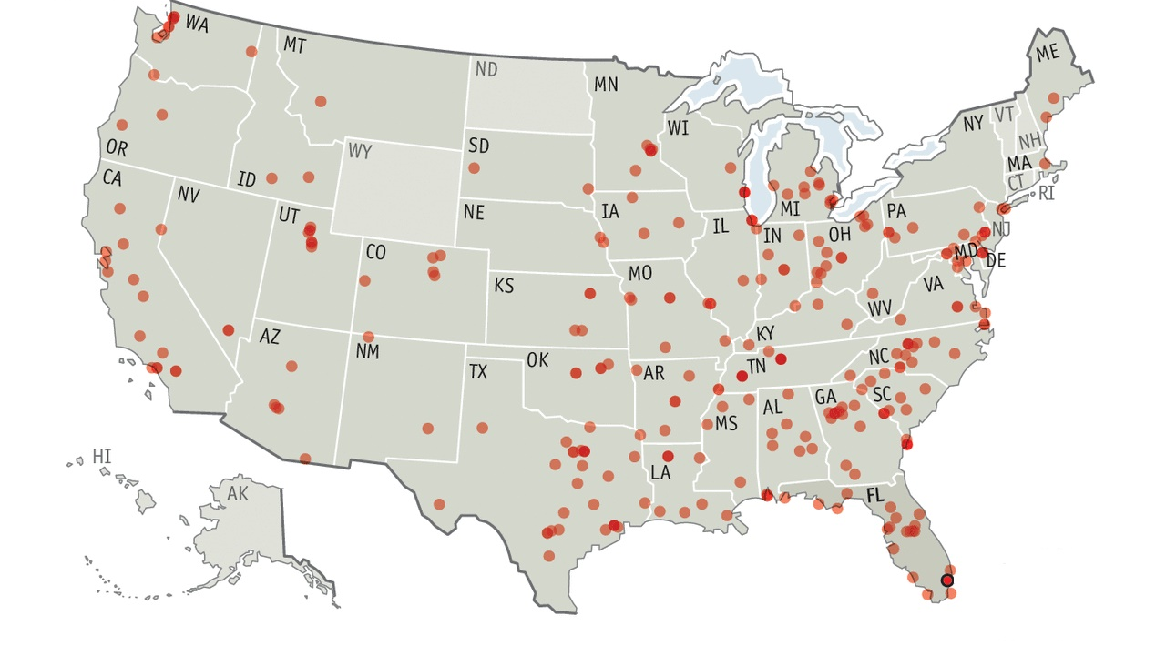
Surviving an Active Shooter

Slide 129
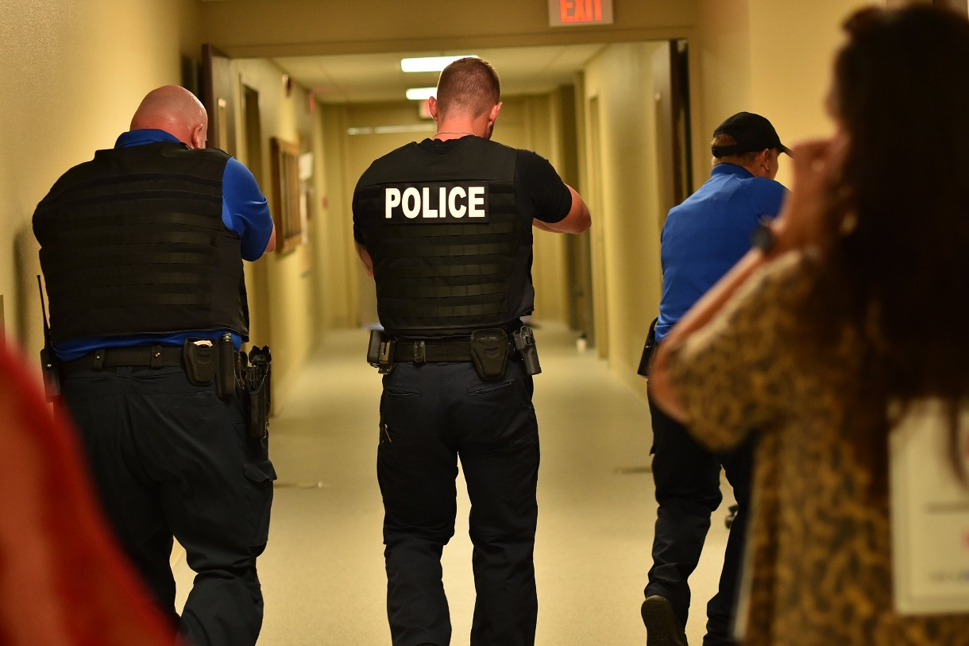
Introduction
According to the Nursing Service Organization (NSO), between 2000 and 2011, 154 hospital-related shootings occurred. In 45% of cases, the shooters were the victims themselves, acting out for reasons such as (but not limited to) grudges, suicide ideation, or the death of a relative.

Slide 130
Introduction
While it is still the best practice for all public and private businesses to have a plan of action before confronted with an aggressive, potentially dangerous person in their spaces, in most cases active shooting situations are random. According to the Department of Homeland Security there is no pattern or method to their selection of victims and can evolve quickly when they do.

Slide 131
Introduction
Furthermore, they add that typically, active shooter situations are often over within 10 to 15 minutes before law enforcement arrives on the scene. Therefore, EVERYONE must be prepared both mentally and physically to deal with an active shooter situation, together, until help arrives.

Slide 132
Introduction
The general consensus among major government agencies and public safety entities, such as the Federal Bureau of Investigation (FBI) and the Federal Emergency Management Agency (FEMA) is that the key to survival during an active shooting event can be broken down into five parts:
1. RUN
2. HIDE
3. BARRICADE
4. FIGHT
5. RECOVER

Slide 133

Run
Be aware of your surroundings and make a mental note of alternate exits; emergency exits are a given but in a pinch windows count as exits as well.

Slide 134
Run
The best exit is AWAY from the line of fire!
Leave belongings, such as bags behind, as they can slow you down.
You can encourage other people to follow you, but if they refuse, just keep running.
Running makes it harder for you to get shot and improves your chance of survival. Seconds matter, so do NOT hesitate!

Slide 135
Hide
The ideal would be a room with a heavy door.
Otherwise, find a spot that is solid enough to slow or stop a bullet, is out of the way, and is dark and shadowy such as under heavy desks, large filing cabinets, or lockers.

Slide 136
Hide
If you have your phone, contact 911 via text messaging instead of calling. This also means you must silence your phone completely, including vibrate, and turn off any other electronic device that might make noise, such as televisions or computers.

Slide 137
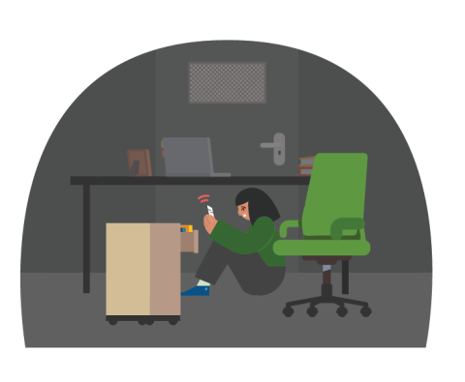
Hide
Posting to social media to alert and update the public – chiefly friends and family – of the situation is a good idea.

Slide 138

Hide
FEMA also suggests not to hide in groups, if possible. If you do happen to have people with you, spread out along the walls as best as you can or split up.

Slide 139
Barricade
If you find a room, lock and block all doors. Use tables, chairs, boxes and any and all heavy objects as barricades. You can use a belt to loop and tighten around protruding door hinges, or a screwdriver on regular hinges if one is available. Do not use items on wheels or your body as barricades. Close all blinds and shutters. Turn off all lights and keep as silent as possible.

Slide 140
Fight
As a last resort you are allowed to FIGHT BACK.
Use the items around you as weapons. Good tools to use are scissors, a fire extinguisher, hardbound books, or paperweights. Obviously do NOT try to fight back with punching or kicking alone.

Slide 141

Fight
If you are with others, make a plan of attack to ambush the gunman: One person can hit the gunman’s torso, another can go for the eyes, and another can trip up the feet, etc.

Slide 142
Fight
Just like them, If you decide to attack, you must be just as aggressive so there must be follow through with your counterattacks.

Slide 143
Recover
You have been through a traumatic experience — make time for some extremely important mental healthcare.
Arrange with your place of work time off, if you can.

Slide 144
Recover
Talking with someone about the traumatic incident is a vital step in moving forward.
Find and connect with mental health resources such as clinical social workers, local counselors, or EAP.

Slide 145
Self-assessment
True or False: As a last resort you are allowed to FIGHT BACK.
Click on the button that corresponds to your answer.
True
False

Slide 146
Self-assessment
The correct answer is: True.
Proceed to the next question. >>>

Slide 147
Self-assessment
True or False: The best exit is TOWARD the line of fire.
Click on the button that corresponds to your answer.
True
False

Slide 148
Self-assessment
The correct answer is: False.
Proceed to the course conclusion. >>>

Slide 149

COURSE CONCLUSION
We do not live in a perfect world. Health and healthcare is already a stressful field, and sometimes... Things get to be too much.

Slide 150
COURSE CONCLUSION
Taking care of others means to take care of each other, not just patients and their loved ones, but colleagues and friends too.
When confronted with a possible crisis, stay calm, stay alert, and stay safe.

Slide 151
COURSE CONCLUSION
For more details regarding the Management of Assaultive Behavior (MAB) AB 508 Workplace Violence Prevention Program, visit https://mabproedu.com. You may also reach out to them via office@MABPRO.com, or dial (888) 619-8880.
What is AB 508?
Open this link to know more about Bill No. AB 508: http://www.leginfo.ca.gov/pub/93-94/bill/asm/ab_0501- 0550/ab_508_bill_931008_chaptered

